Slide 1
LOS ADJETIVOS
Adjectives describe nouns.
Are important because we use them when we have a job interview, in an emergency or in any situation.

Slide 2
Rules for adjectives GENDER
Masculine: ends in “o”
For example: alto (tall)
Feminine: ends in “a”
For example: baja (short)
Some are neutral: EX: fuerte(strong), débil(weak), grande(big)= (for both genders).

Slide 3
SINGULAR-PLURAL
If it ends in a “Vocal” (Vowel) you add an “S” to make it Plural.
Singular: Alto (tall)
Plural: Altos (tall-plural)
If it ends in a consonant, add “es” to make it Plural.
Singular: Debil (weak)
Plural: debiles (weak-Plural)

Slide 4
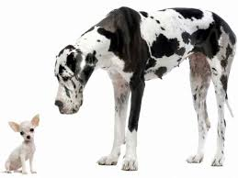
ADJECTIVES: Physical Characteristics
Grande/Big
Pequeño/Small

Slide 5
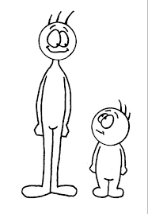
Physical Characteristics
Alto/Tall
Bajo/Short

Slide 6
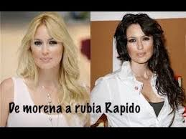
ADJECTIVES: Physical Characteristics
Rubio/blond
Moreno/Brown
CASTANA

Slide 7
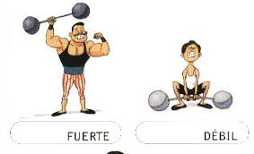
ADJECTIVES: Physical Characteristics
Fuerte/Strong
Débil/Weak

Slide 8
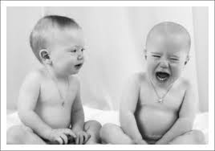
ADJECTIVES: Personality
Simpático/Nice
Antipático/Not nice

Slide 9
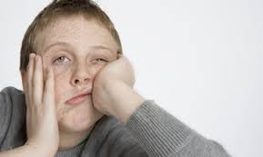
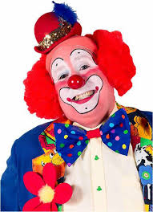
ADJECTIVES: Personality
Gracioso/Funny
TRABAJADOR-PEREZOSO/FLOJO
GENEROSO-TACAÑO
BUENO-MALO
HONESTO-DESHONESTO
Aburrido/Boring

Slide 10
PRACTICE
Describe yourself: Write at least tres (3) physical characteristics and dos (2) characteristics about your personality.

