Slide 4
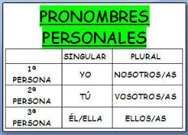
BEST WAY TO MEMORIZE THEM
Write them in order
YO | NOSOTROS
TÚ | VOSOTROS
Él/Ella | Uds./Ellos/Ellas

Slide 9
PRACTICA

